Slide 1

Smart Meeting Scheduler
AI-Powered Team Collaboration
Devanshi Mathan | Er. No.: 221B142 | For Role: AI/ML Engineer

Slide 2



What is the Smart Meeting Scheduler?
The Smart Meeting Scheduler is an innovative web application designed to streamline team collaboration through intelligent automation.
Intuitive Web App
AI-Powered Intent Detection
Automated Scheduling
Transforms team chat platforms into a sophisticated, AI-driven meeting planner.
Utilizes advanced AI to recognize meeting intent and participant availability from natural language conversations.
Seamlessly schedules and confirms meetings, eliminating manual coordination efforts.

Slide 3





Core Features
Integrated Group Chat
Intelligent Message Analysis
Dynamic Availability Extraction
Facilitates real-time communication among multiple team members within the application.
AI algorithms meticulously analyze chat messages to identify scheduling triggers and preferences.
Extracts and processes availability information directly from conversational text.
Optimal Time Suggestion
Automated Confirmations
Proposes the most suitable meeting times that accommodate all participants' schedules.
Dispatches meeting confirmation emails to all attendees upon successful scheduling.

Slide 4
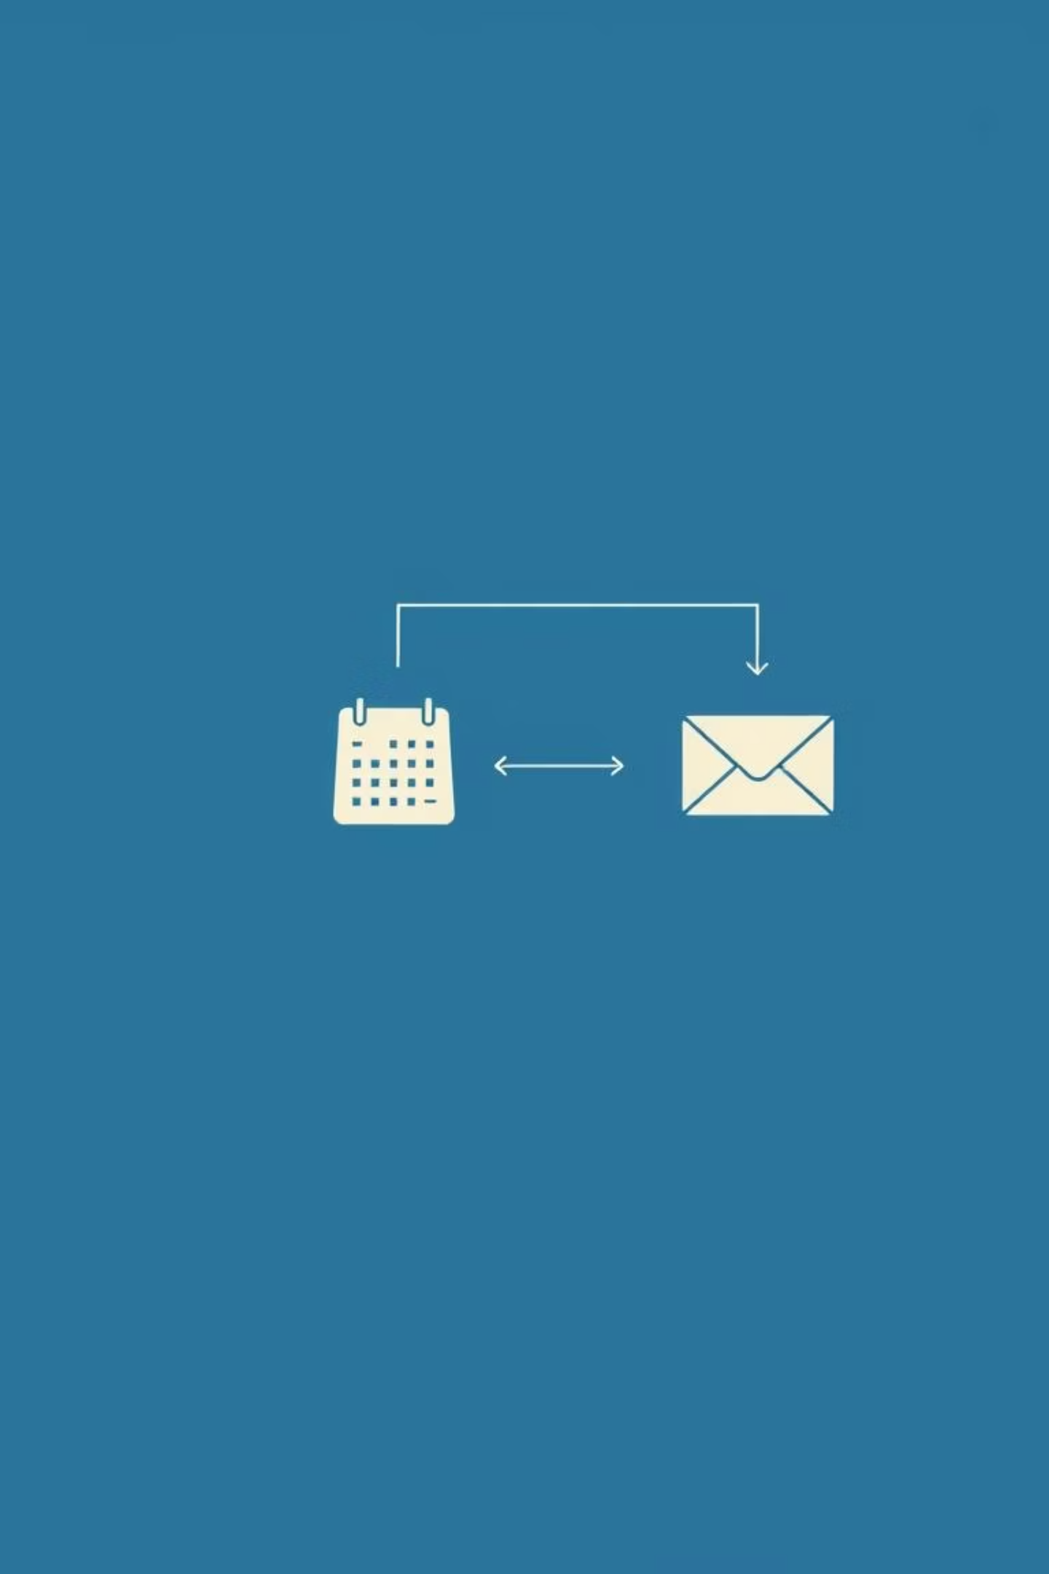
How It Works
01
Natural Conversation
Users engage in natural chat, subtly mentioning meeting intentions or desired times.
02
AI Detection & Preference Gathering
The AI system proactively detects meeting-related keywords and aggregates participant preferences.
03
Optimal Slot Identification
The application computes and identifies the most convenient time slot that minimizes conflicts.
04
Instant Confirmation
Confirmation emails are automatically generated and sent to all involved parties, finalizing the meeting.

Slide 5
Technology Stack
The Smart Meeting Scheduler is built upon a robust and efficient technology stack, ensuring scalability and performance.
Backend
Frontend
AI/NLP
Email
Flask (Python): A micro-framework for rapid API development.
HTML: For structuring the web application's content.
Custom Logic: Tailored algorithms for precise intent recognition and availability extraction from natural language.
Python SMTP Module: Utilized for simulating email sending capabilities for meeting confirmations.
CSS: For styling and responsive design across devices.
SQLite: A lightweight, file-based database for local data storage.
JavaScript: For interactive elements and dynamic user experiences.

Slide 6
Database Structure
The database is designed for efficient storage and retrieval of user, message, and meeting data.
Users
Name, Email
Stores participant profiles for identification and contact.
Messages
UserID, ChatContent, Timestamp
Captures chat interactions, linked to users for context.
Meetings
Title, Date, Time, Participants (FK)
Records details of scheduled meetings and attendees.

Slide 7

How Does the AI Work?
The AI engine is at the core of the Smart Meeting Scheduler, interpreting conversations to facilitate seamless scheduling.
Intent Detection
The AI analyzes chat messages to detect "meeting intent" by identifying keywords and contextual cues related to scheduling.
Text Parsing
It then parses the conversation text to extract specific details like preferred days, dates, and time mentions from natural language.
Optimal Slot Calculation
Using the extracted information, the AI calculates the best possible time slots that maximize overlap and minimize conflicts among all participants.
Intelligent Follow-up
If insufficient information is available, the AI intelligently prompts users for additional details to ensure accurate scheduling.

Slide 8
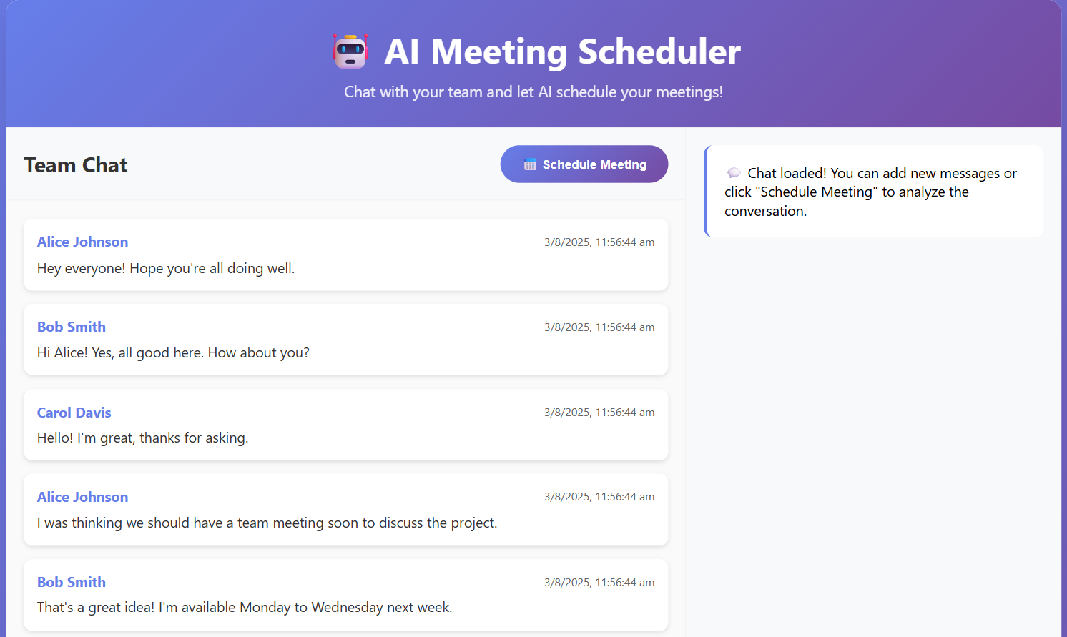
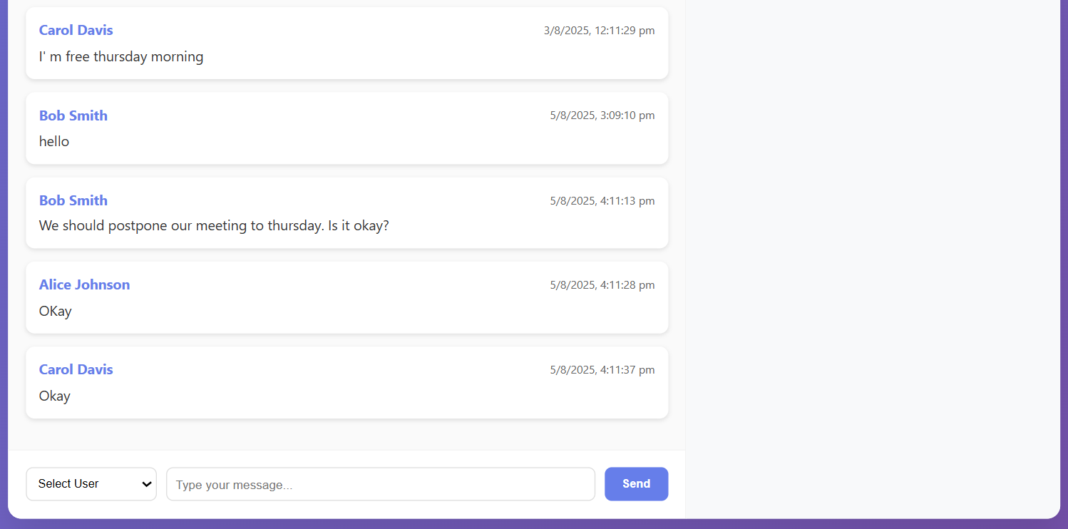
User Interface Snapshot
A glimpse into the intuitive and user-friendly interface of the Smart Meeting Scheduler.

Slide 9
Future Enhancements
Our roadmap includes several key improvements to expand the Smart Meeting Scheduler's capabilities and enhance user experience.
Calendar Integration: Seamless integration with popular calendar services like Google Calendar and Outlook Calendar for real-time availability and automatic event creation.
Time Zone & Working Hours Support: Advanced features to account for global teams, including time zone conversion and customizable working hour preferences.
Enhanced NLP: More sophisticated natural language processing to handle complex sentences, slang, and diverse conversational styles for improved accuracy.
Security & Authentication: Implementation of robust authentication protocols and security measures to protect user data and ensure privacy.
Multi-platform Support: Development of mobile applications (iOS/Android) and desktop clients for broader accessibility.

Slide 10

Thank You!
Questions? Feedback?

